Slide 1

Codehelper CS5351: Software Engineering Project Presentation
CHEN Guanhao, LAN Yetian, LIANG Tianyi,
LIU Ruidan, NIE Zhinie, WANG Ye

Slide 2

Outline
Software Introduction
Software Process (Extreme Programming)
Software Demo
Software Evaluation
Outlook

Slide 3
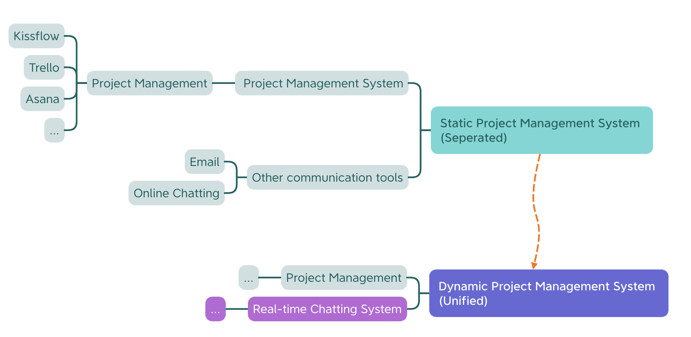
1. Software Introduction: Motivation
Motivation: Build up dynamic project management system combining with real-time chatting system.

Slide 4
1. Software Introduction: User Story
User Stories (Required):
1. Users can signup & login their account.
2. Users can create group / invite other users to discuss details of their project.
3. The groups created by users should be established as chatrooms.
4. Every group has a calendar and a to-do list to illustrate the schedule of the project.
5. The calendar of the project shows the deadline for each project.
6. Users can modify the details of the project by adding tasks or deleting tasks.
7. Users can also discuss with other users directly rather than discuss in groups.

Slide 5
1. Software Introduction
User Stories (Optional):
8. Users may use APIs to access the search engines or chatbots(e.g. ChatGPT).
9. Users may summary their weekly works in this software.
User Stories | Expecting hours | Priority
1 | 10 | 5
2 | 10 | 4
3 | 20 | 1
4 | 20 | 3
5 | 20 | 2
6 | 10 | 6
7 | 10 | 7
8 | 10 | 8
9 | 10 | 9

Slide 6
1. Software Introduction: Requirements
Functional Requirements:
1. When users create/login their accounts, the system returns a new/existed account.
2. When users create a group of a project, the system returns a new chatroom.
3. When users change the group information, the data will be changed accordingly.
4. When users change the project information, the data will be changed accordingly.
5. Users can upload their works/projects on GitHub.
Non-Functional Requirements:
1. The software can provide real-time communication.
2. The software can be installed and deployed in different platforms.
3. The software should not disclose users’ information.

Slide 7
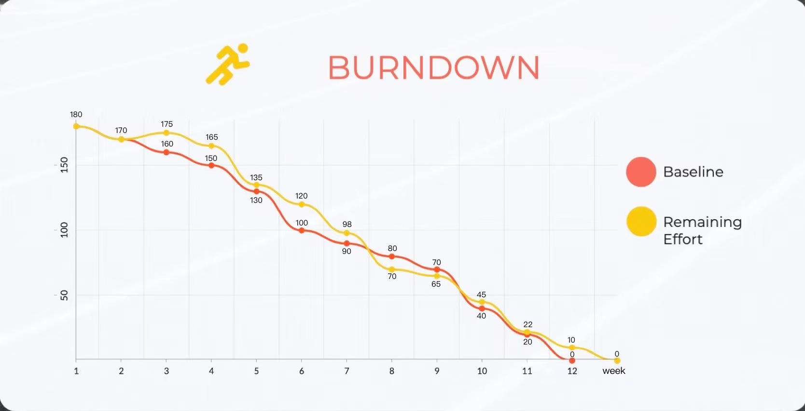
1. Software Introduction: Our work

Slide 8
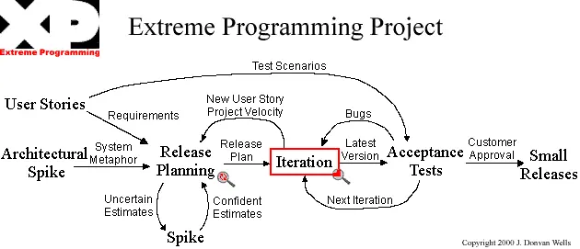
Agile Method: Extreme Programming (XP)

Slide 9
2. Extreme Programming: Software Design
Project Technology Choices:
Frontend:
Vue, JavaScript, TypeScript
Backend:
MySQL, Nodejs, JavaScript, NestJS, TypeORM
Project Management Tool:
Modern Code Review: GitHub’s pull request
Documentation: Microsoft Teams

Slide 10
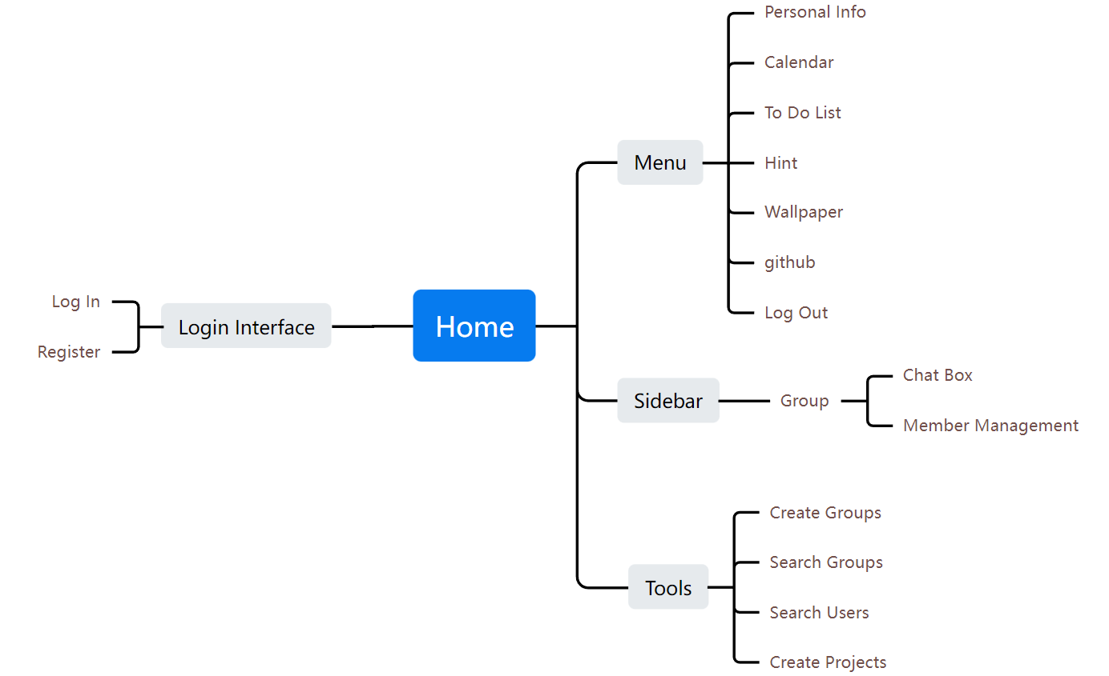
2. Extreme Programming: First Version (Frontend)
The Sitemap for Codecode.

Slide 11
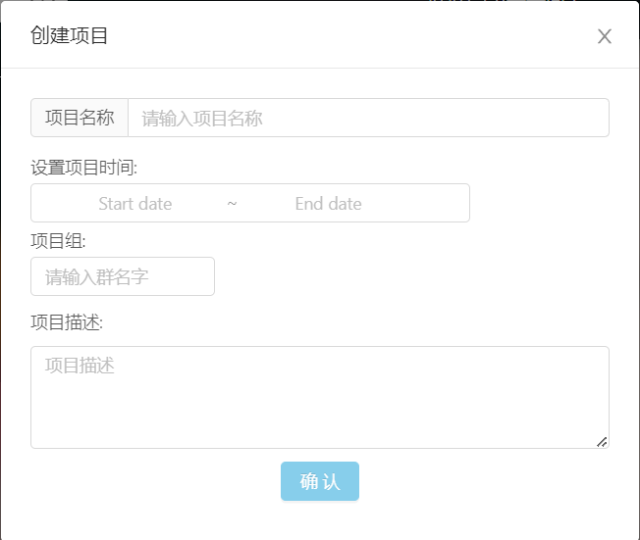
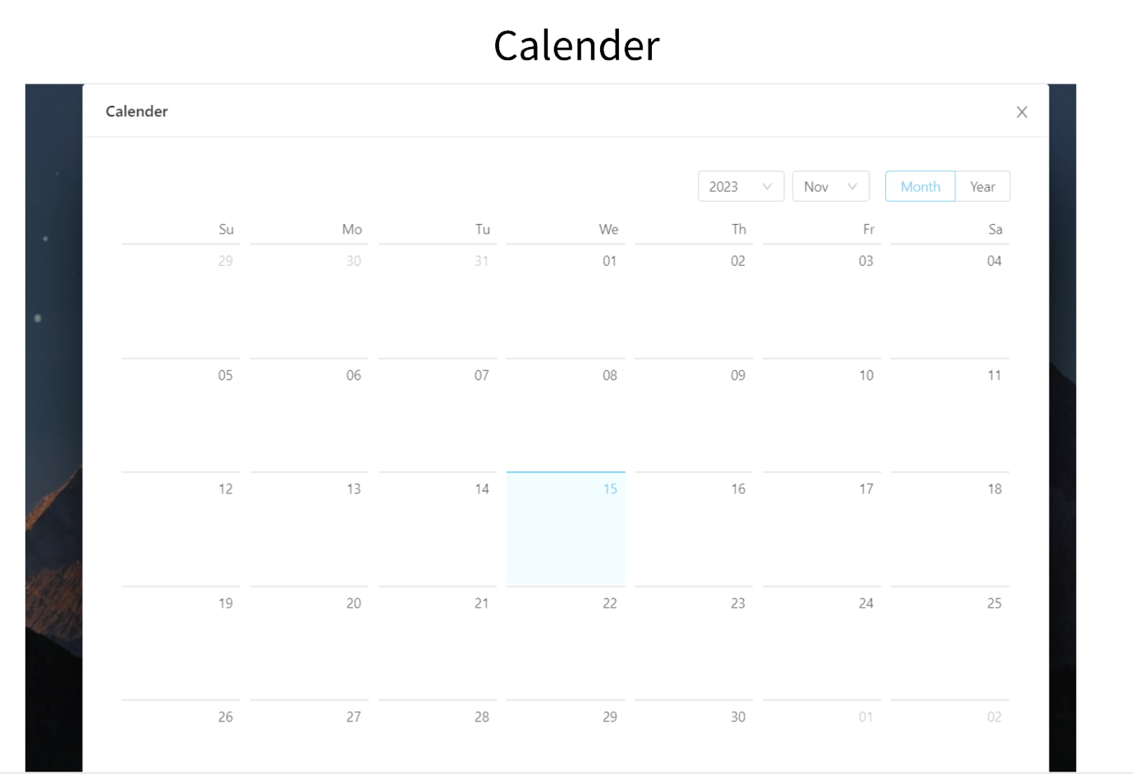
2. Extreme Programming: First Version (Frontend)
The project module and the calendar.

Slide 12
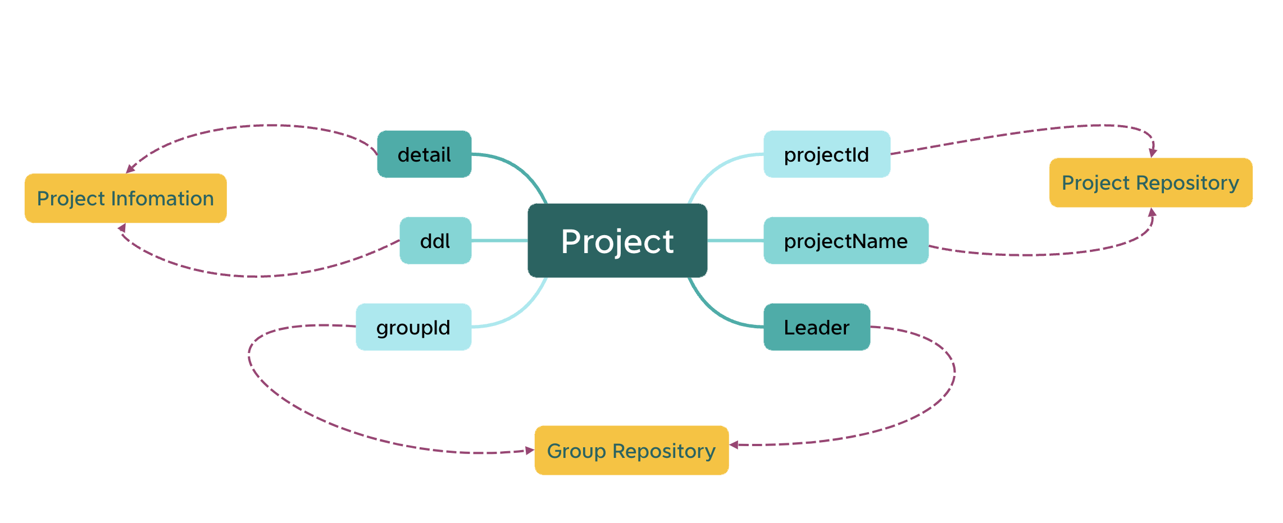
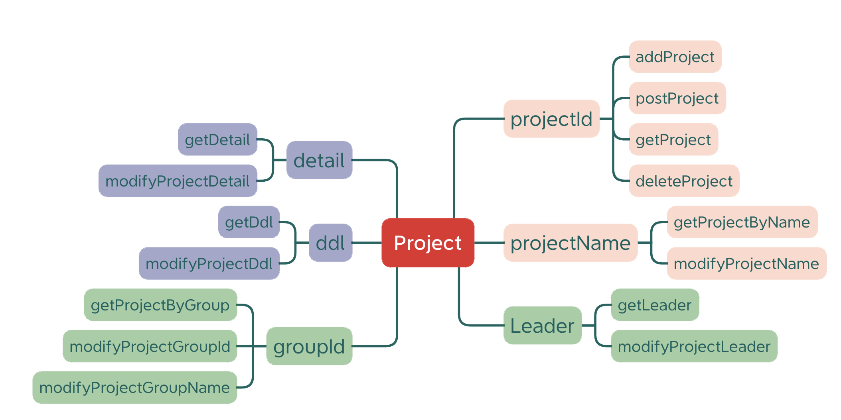
2. Extreme Programming: First Version (Backend)

Slide 13
2. Extreme Programming: Feedback
Challenges:
Current query methods implemented between users and their project are inefficient.
User -> Group -> Project
Cannot show whether a user has completed his / her works.
Lack a new feature to illustrate this personal status.
Solutions:
Also add ‘userId’ to the project module to simplify the query: User -> Project.
Add ‘Tag’ to the project module to illustrate whether a user has finished his / her works.

Slide 14
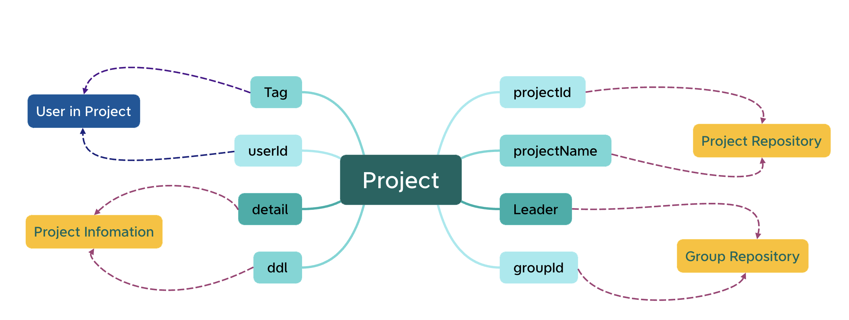
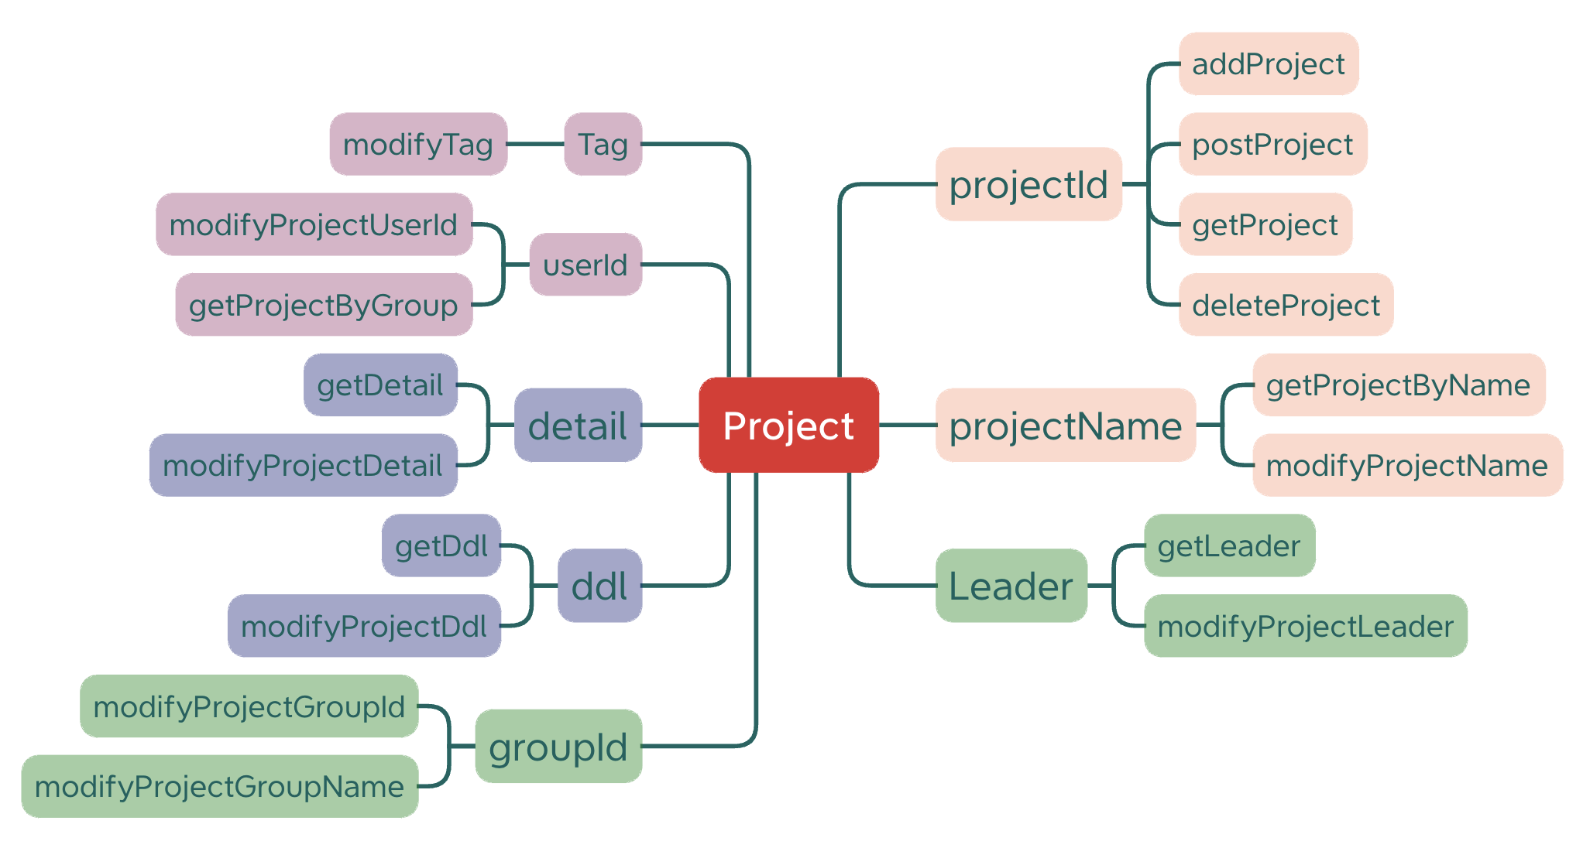
2. Extreme Programming: Second Version

Slide 15
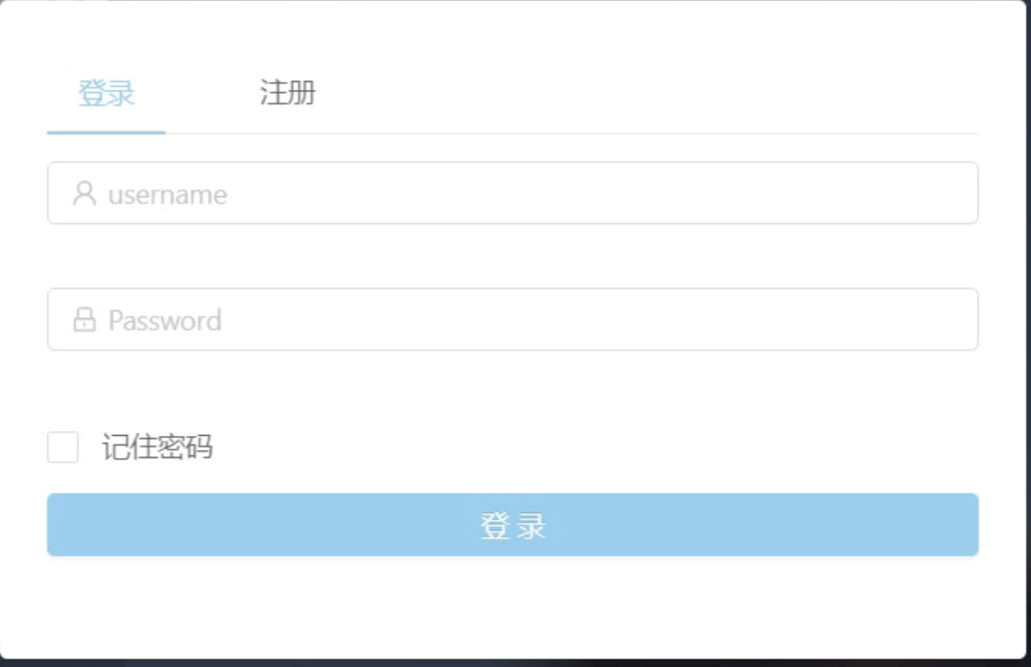
3. Software Demo: Create Account / Login

Slide 16
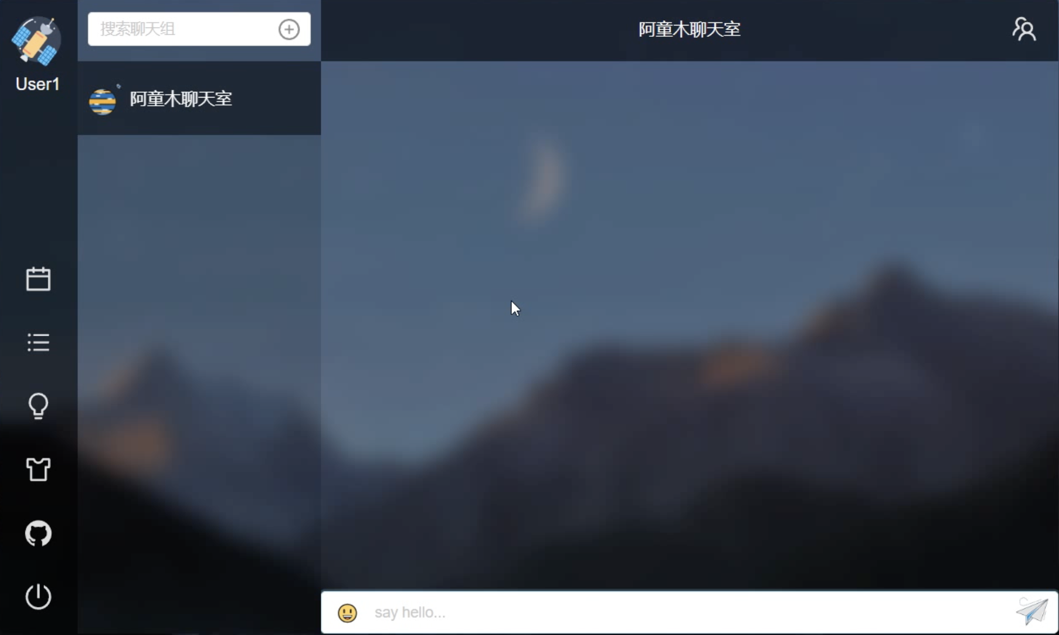
3. Software Demo: User Interface

Slide 17
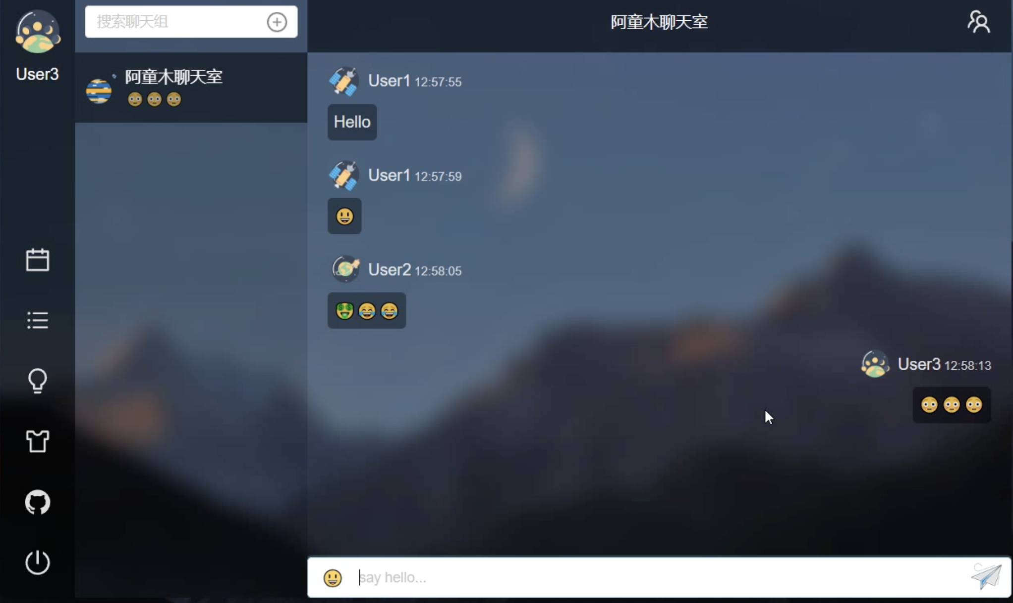
3. Software Demo: Group Discussion

Slide 18
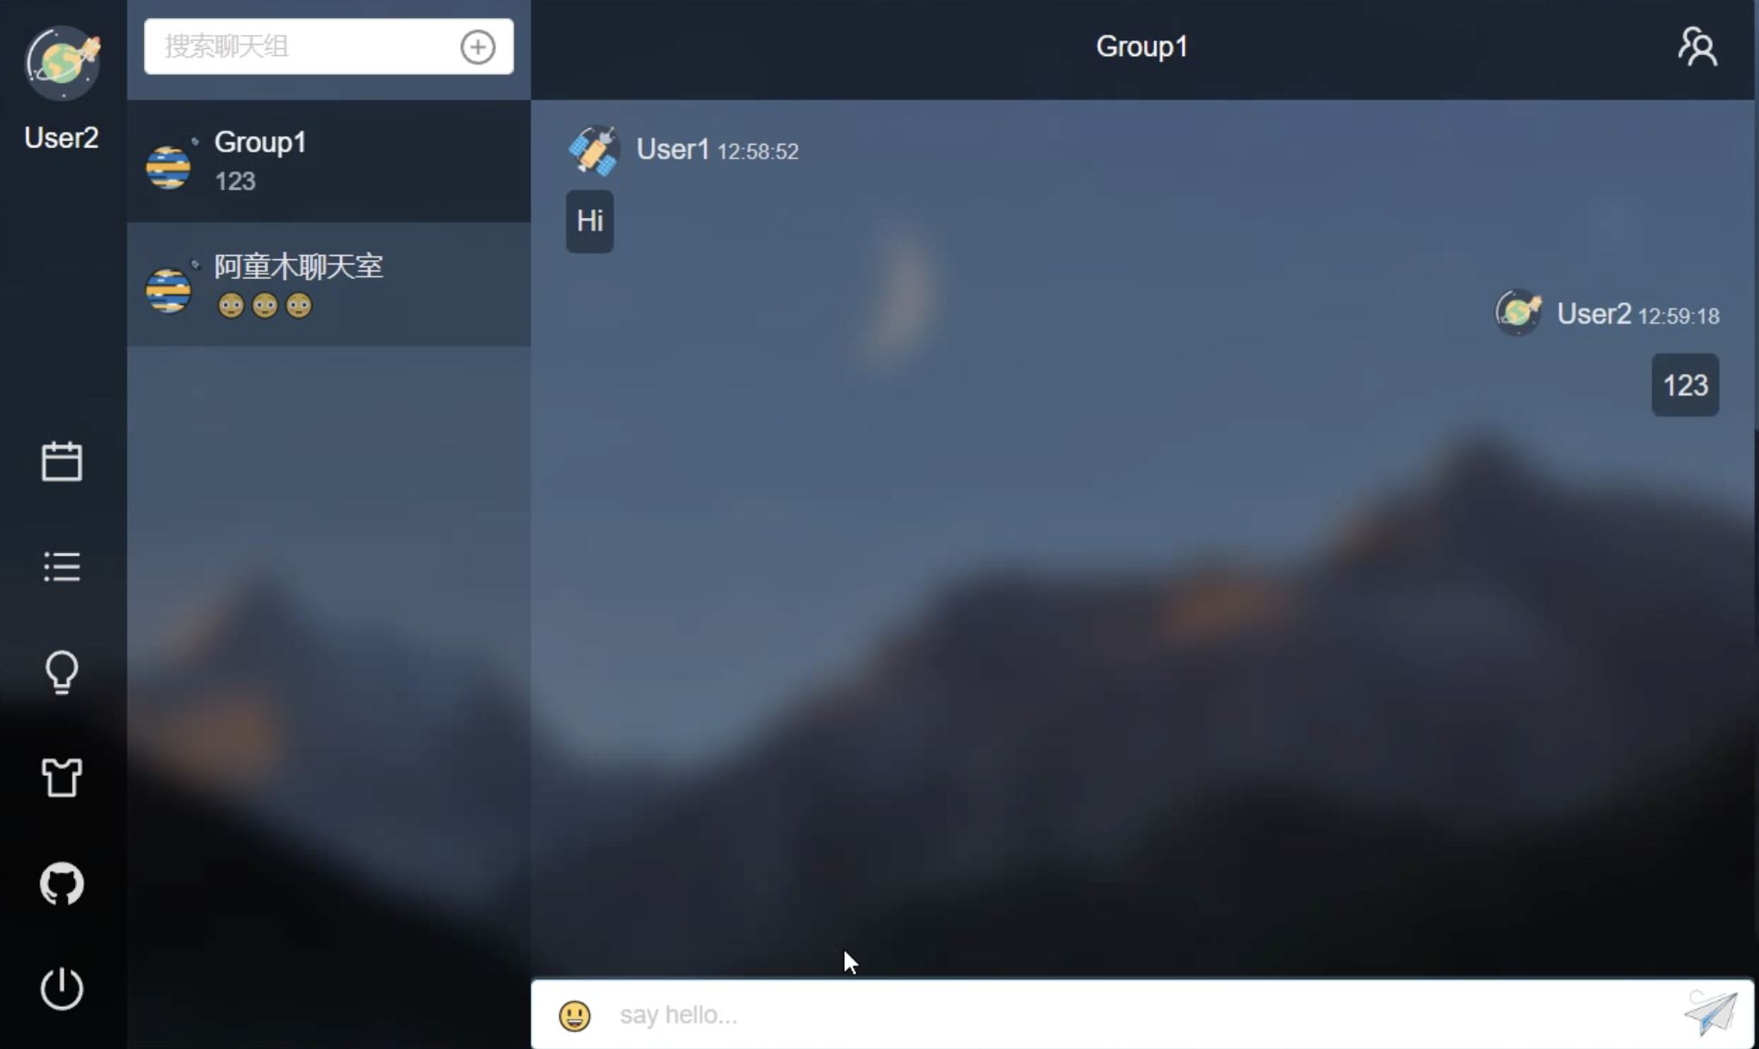
3. Software Demo: Friend Conversation

Slide 19
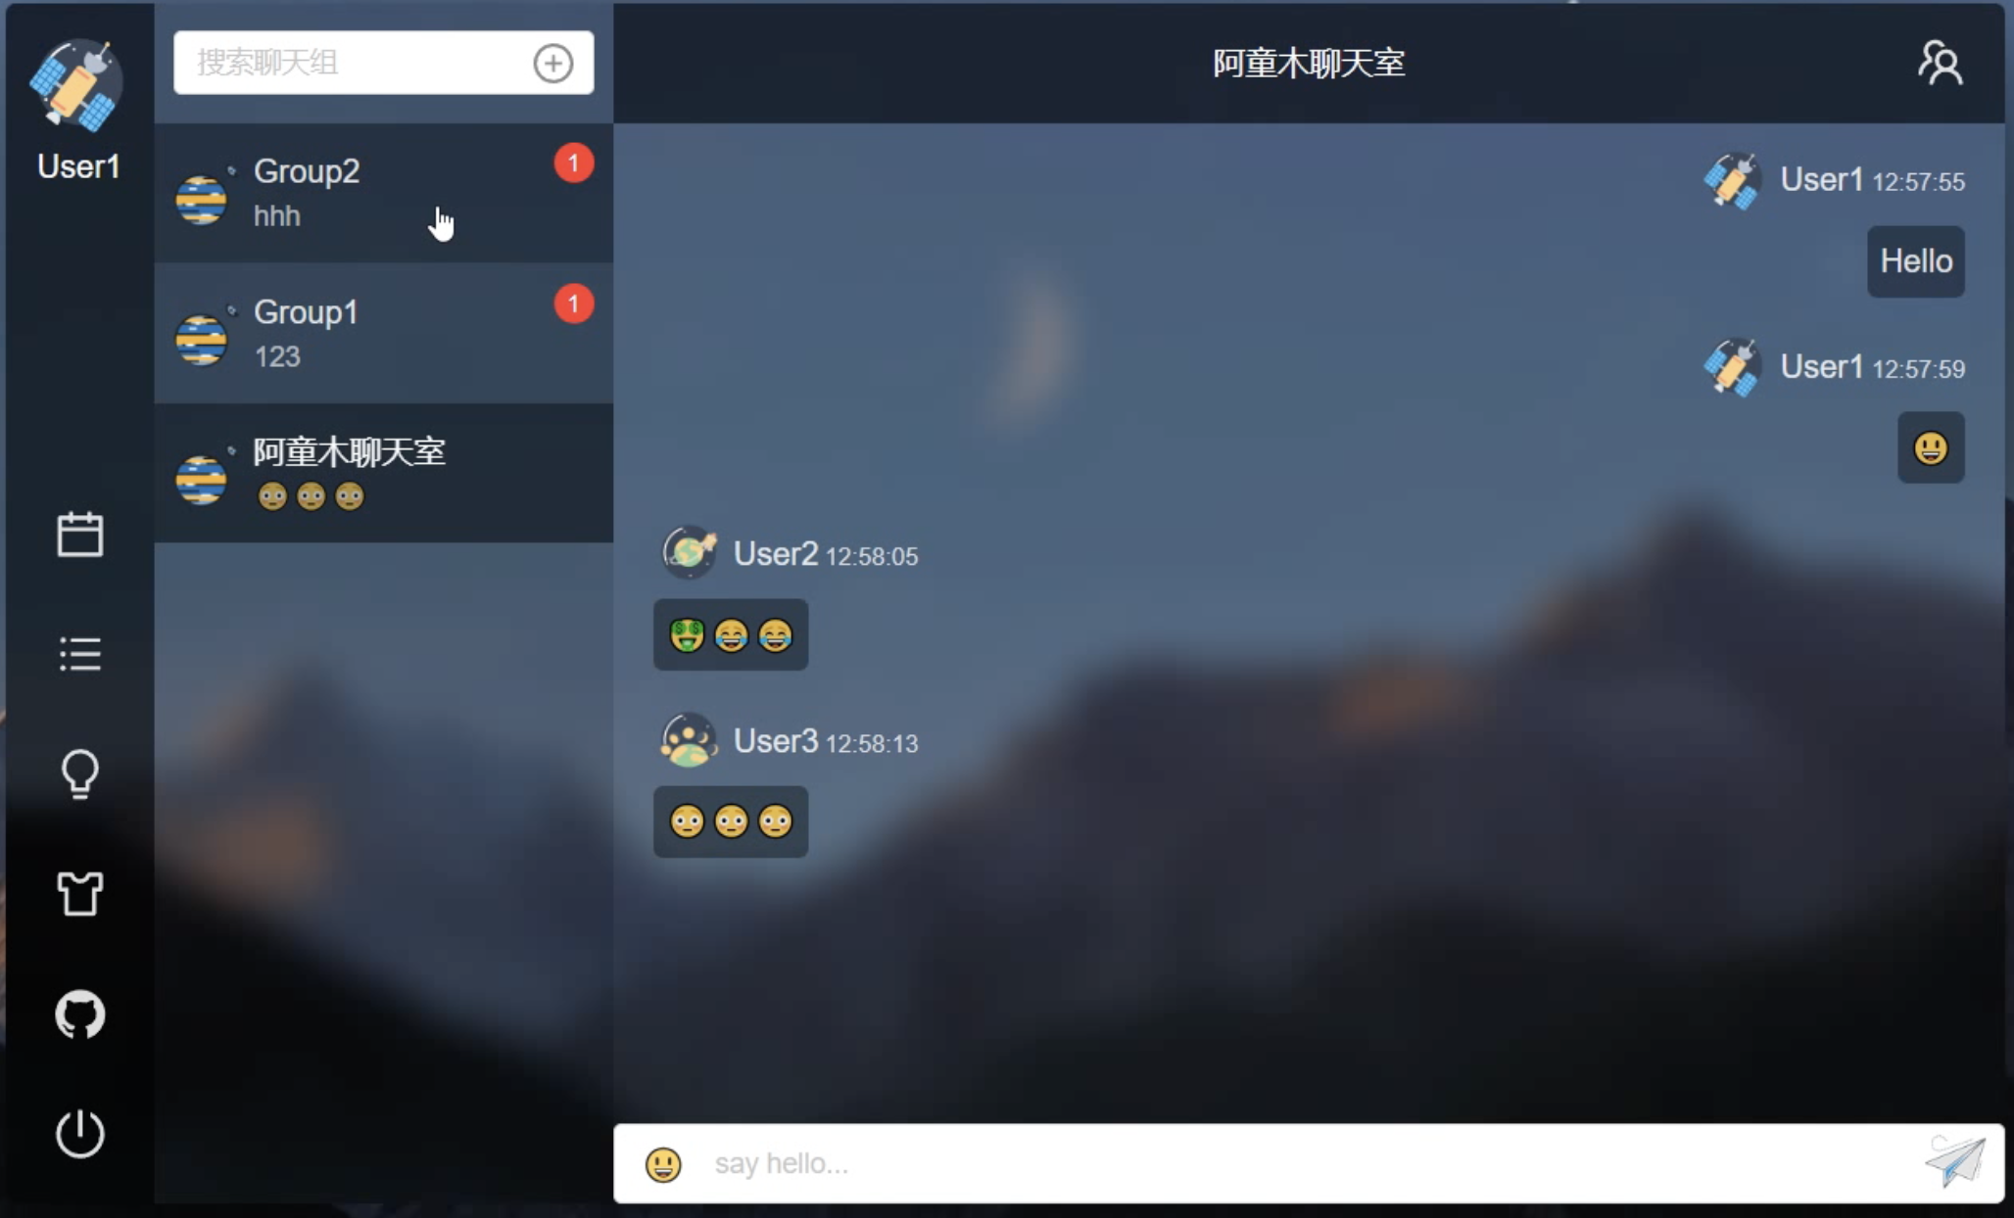
3. Software Demo: Message Notification

Slide 20
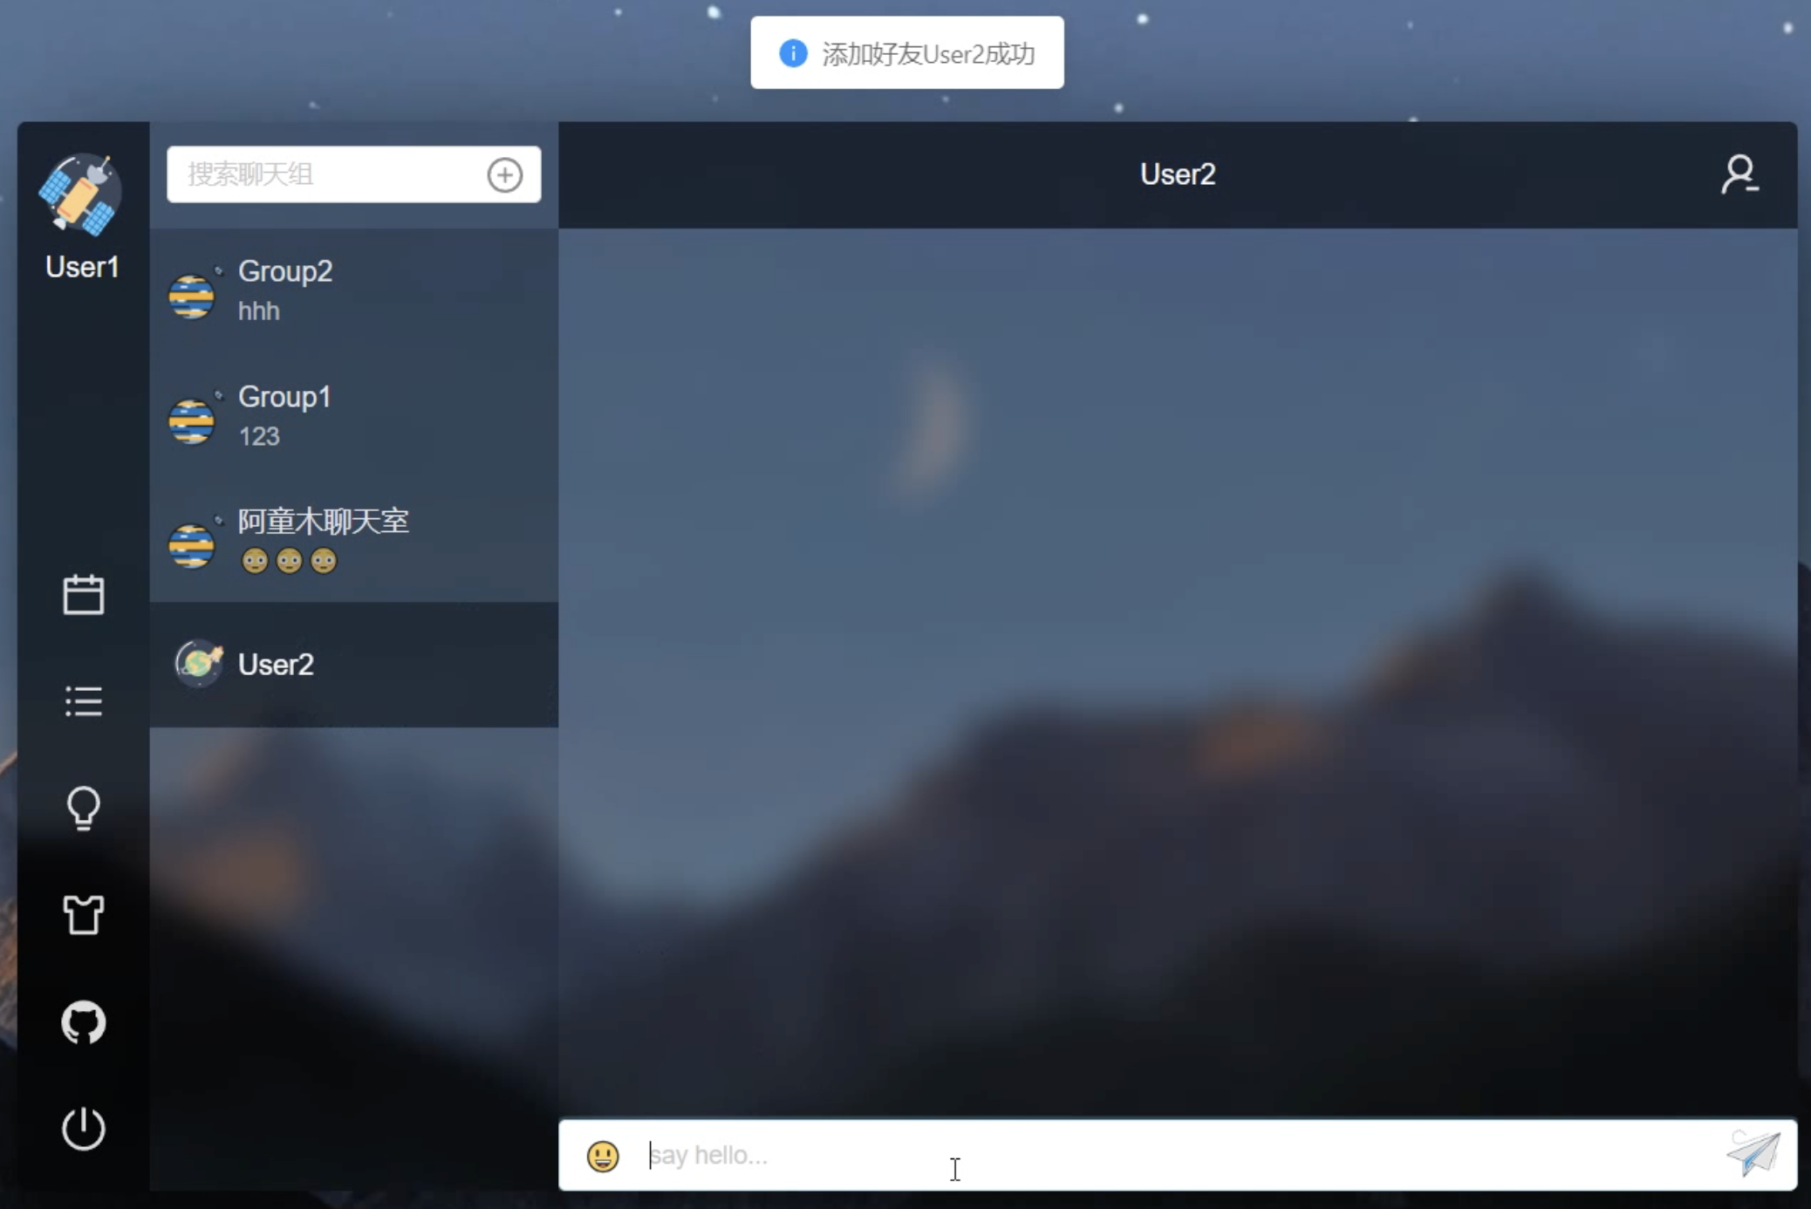
3. Software Demo: Add Friend / Delete Friend

Slide 21
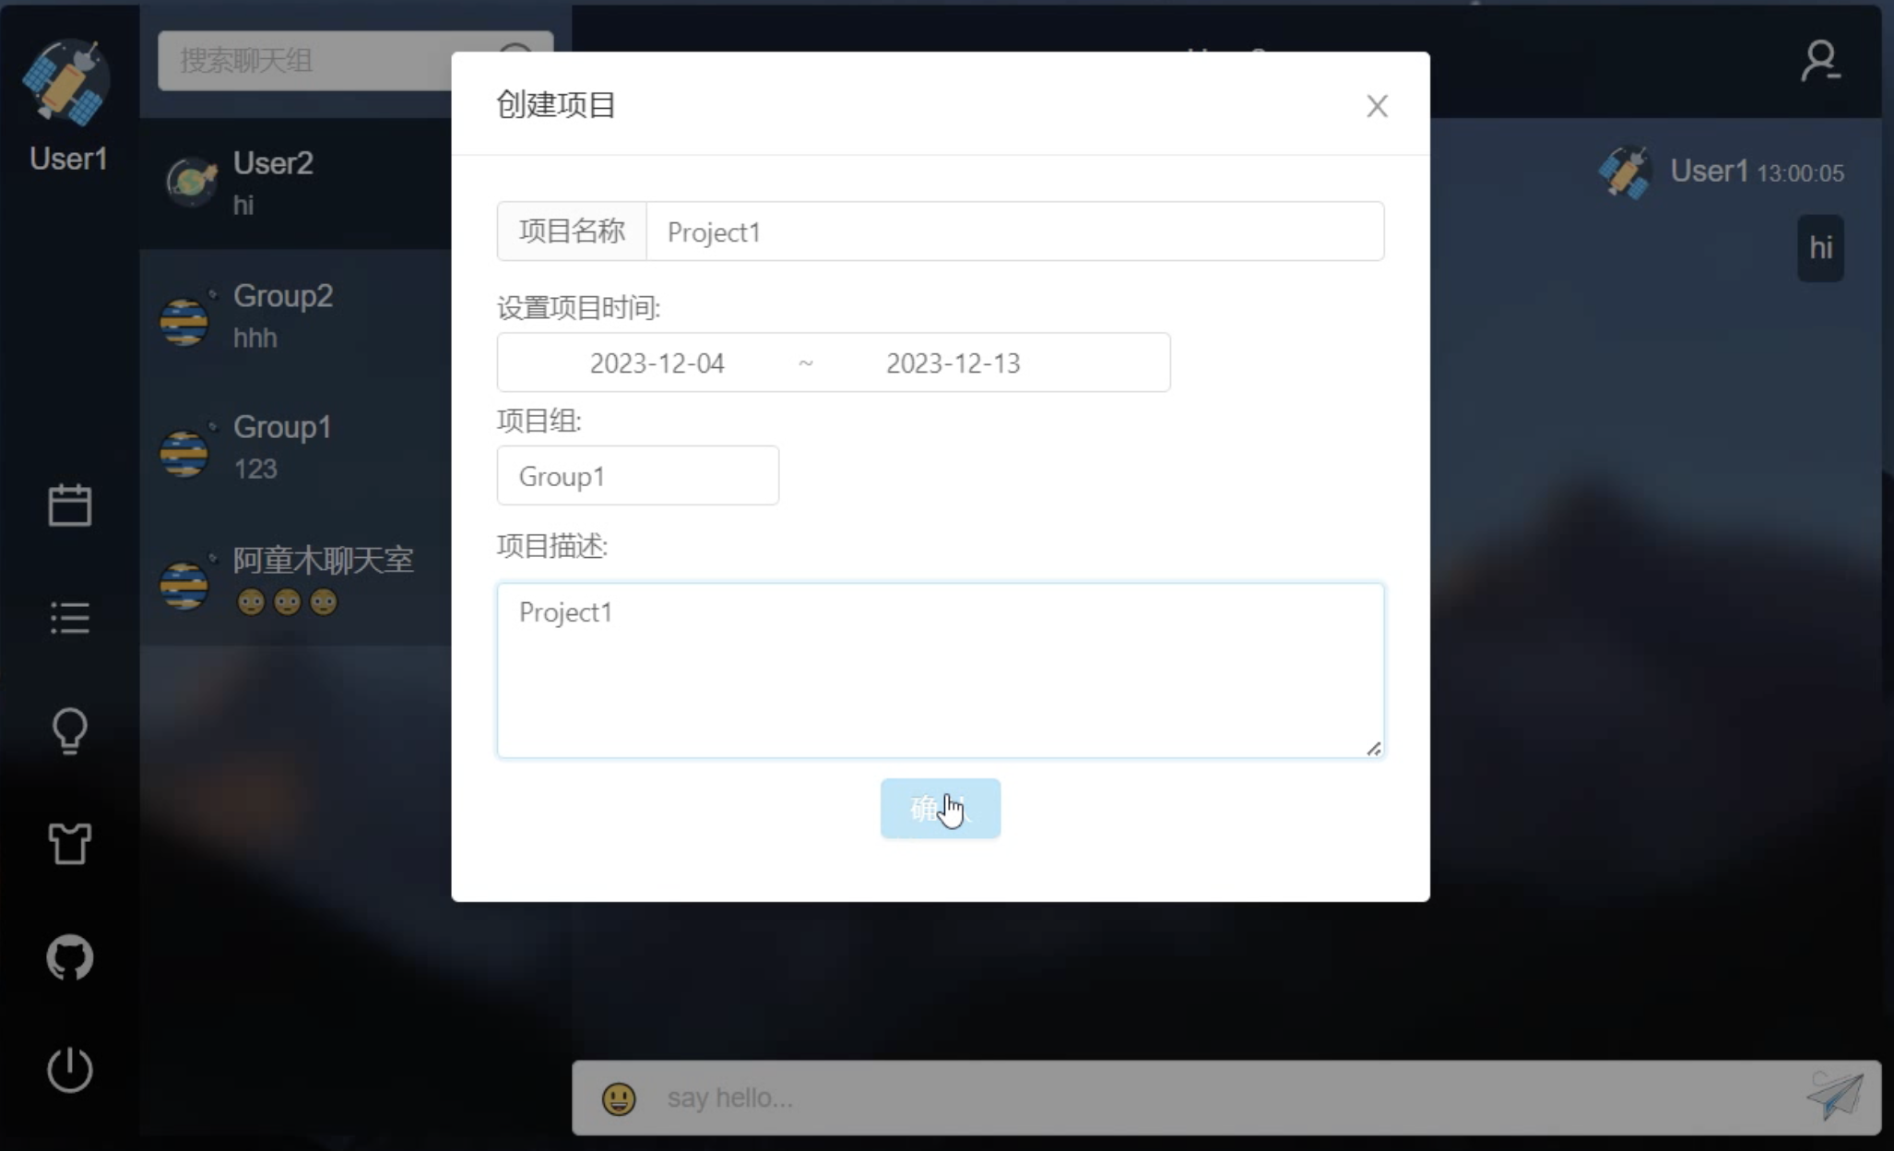
3. Software Demo: Create New Project

Slide 22
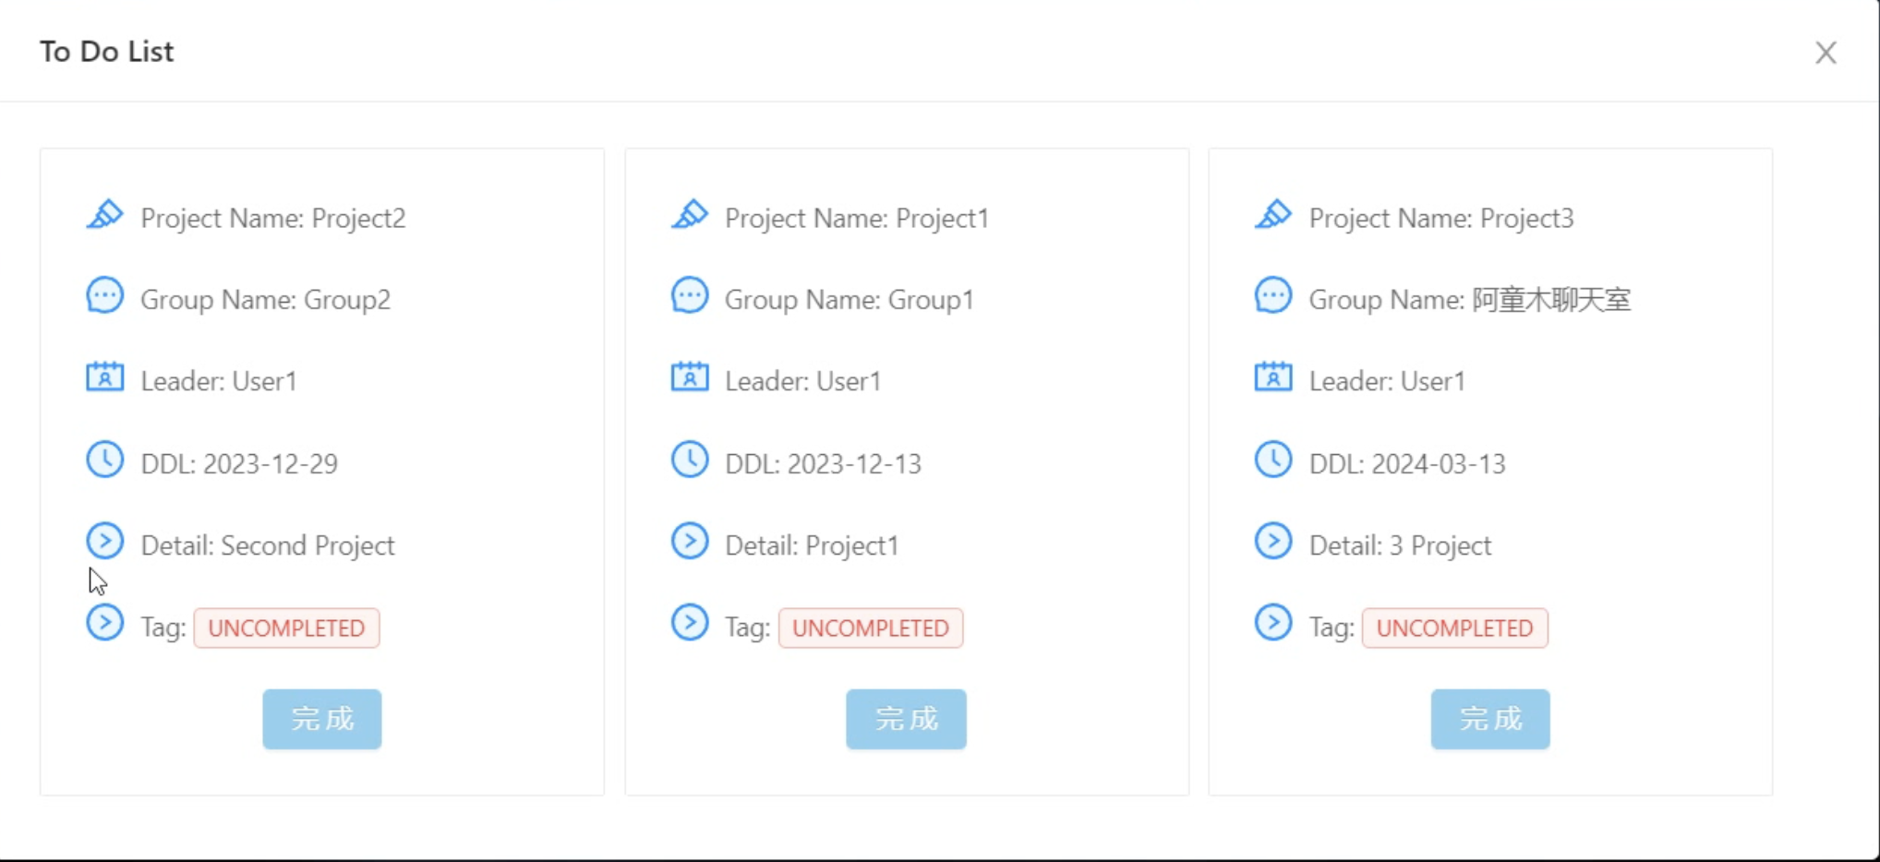
3. Software Demo: User’s To Do List (Work Uncompleted)

Slide 23
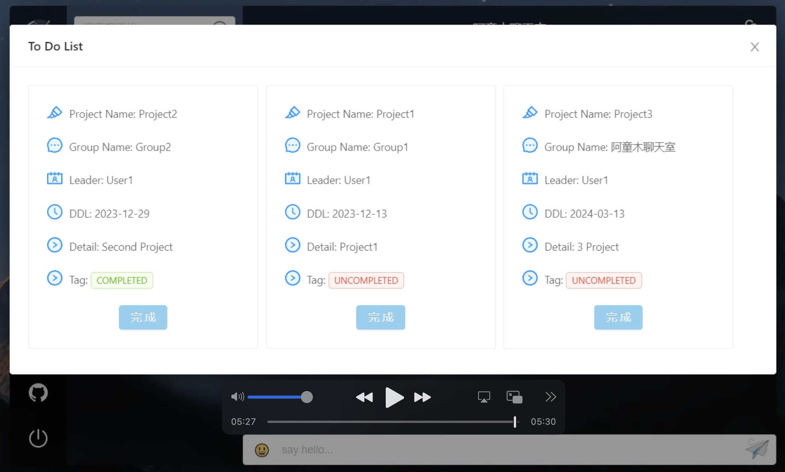
3. Software Demo: User’s To Do List (Work Completed)

Slide 24
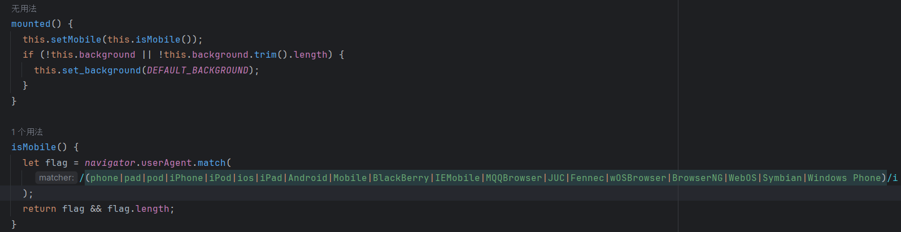
4. Software Evaluation: Advantages
Advantages
1. We create a dynamic project management system combined with chatting system.
2. It can be deployed in different devices.

Slide 25
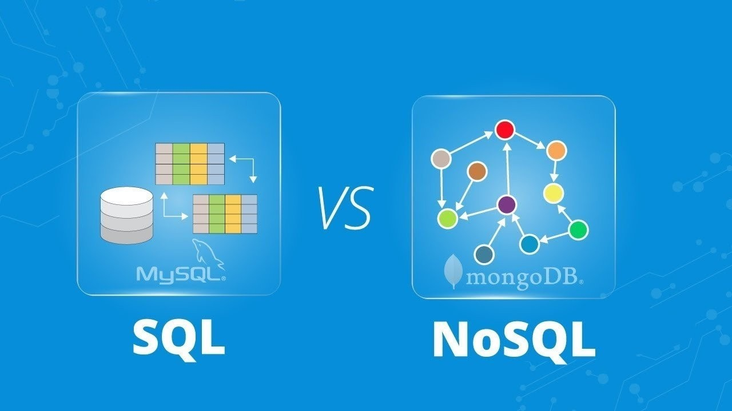
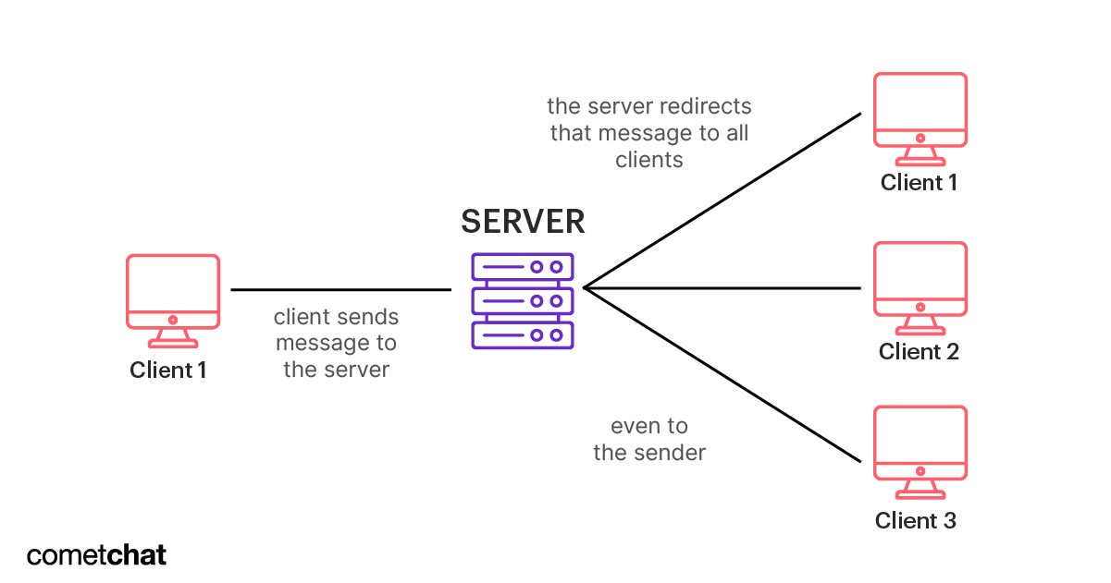
4. Software Evaluation: Shortcomings
Shortcomings
1. Rigid Architecture
2. Lack Server Support

Slide 26
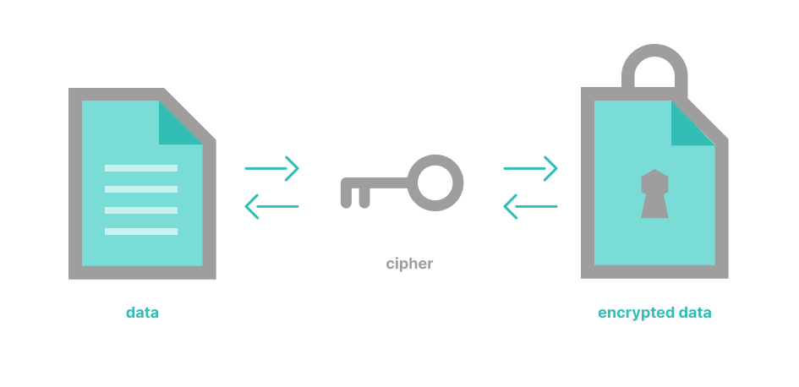
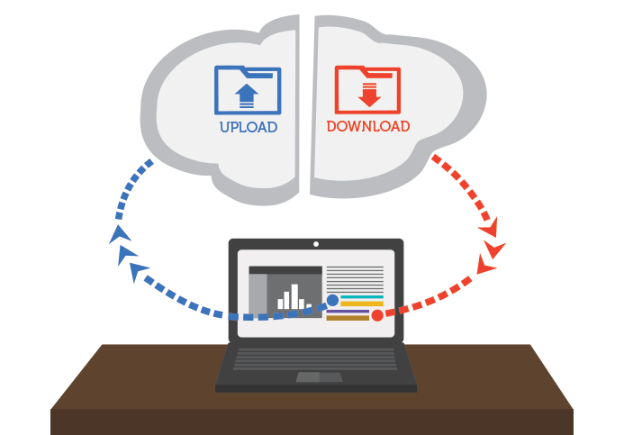
5. Outlook
Software Security
1. Database Encryption
Network Communication
1. Upload / Download Files
Other Requirements
1. Record the users’ weekly works.
2. Record the technical debts of the software project.
3. Access to search engines or chatbots.

Slide 27
Reference
[1] Ionescu, B., Gadea, C., Solomon, B., Trifan, M., Ionescu, D., & Stoicu-Tivadar, V. (2015, May). A chat-centric collaborative environment for web-based real-time collaboration. In 2015 IEEE 10th jubilee international symposium on applied computational intelligence and informatics (pp. 105-110). IEEE.
[2] Ehsan, O., Hassan, S., Mezouar, M. E., & Zou, Y. (2020). An empirical study of developer discussions in the gitter platform. ACM Transactions on Software Engineering and Methodology (TOSEM), 30(1), 1-39.
[3] Weger Jr, H., & Aakhus, M. (2003). Arguing in Internet chat rooms: Argumentative adaptations to chat room design and some consequences for public deliberation at a distance. Argumentation and advocacy, 40(1), 23-38.
[4] Pan, S., Bao, L., Ren, X., Xia, X., Lo, D., & Li, S. (2021, November). Automating developer chat mining. In 2021 36th IEEE/ACM International Conference on Automated Software Engineering (ASE) (pp. 854-866). IEEE.

Slide 28
Reference
[5] Kim, S., Eun, J., Oh, C., Suh, B., & Lee, J. (2020, April). Bot in the bunch: Facilitating group chat discussion by improving efficiency and participation with a chatbot. In Proceedings of the 2020 CHI Conference on Human Factors in Computing Systems (pp. 1-13).
[6] Bastian, A., Solihin, M. A., Irdan, A. A., & Jalal, N. M. (2021). Design and Build Chatroom Application as Student Consultation Media Based on Android. INTEK: Jurnal Penelitian, 8(2), 151-156.
[7] Henriyan, D., Subiyanti, D. P., Fauzian, R., Anggraini, D., Aziz, M. V. G., & Prihatmanto, A. S. (2016, October). Design and implementation of web based real time chat interfacing server. In 2016 6th International Conference on System Engineering and Technology (ICSET) (pp. 83-87). IEEE.
[8] El Mezouar, M., da Costa, D. A., German, D. M., & Zou, Y. (2021). Exploring the use of chatrooms by developers: An empirical study on slack and gitter. IEEE Transactions on Software Engineering, 48(10), 3988-4001.

Slide 29
Reference
[9] Wang, D., Wang, H., Yu, M., Ashktorab, Z., & Tan, M. (2022). Group chat ecology in enterprise instant messaging: How employees collaborate through multi-user chat channels on slack. Proceedings of the ACM on Human-Computer Interaction, 6(CSCW1), 1-14.
[10] Sahar, H., Hindle, A., & Bezemer, C. P. (2021). How are issue reports discussed in Gitter chat rooms?. Journal of Systems and Software, 172, 110852.
[11] Bian, J., Seker, R., & Topaloglu, U. (2007, August). Off-the-record instant messaging for group conversation. In 2007 IEEE International Conference on Information Reuse and Integration (pp. 79-84). IEEE.
[12] Lee, S. C., Song, J., Ko, E. Y., Park, S., Kim, J., & Kim, J. (2020, April). Solutionchat: Real-time moderator support for chat-based structured discussion. In Proceedings of the 2020 CHI Conference on Human Factors in Computing Systems (pp. 1-12).

Slide 30
Reference
[13] http://www.extremeprogramming.org/rules.html
[14] https://en.wikipedia.org/wiki/Frontend_and_backend

Slide 31
Thanks for listening!
CHEN Guanhao, LAN Yetian, LIANG Tianyi,
LIU Ruidan, NIE Zhinie, WANG Ye

